Slide 1
Irish Writers Union Webinar:
AI, copyright and authors – what do we need to think about?
Samantha Holman, CEO, ICLA
19 September 2023

Slide 2
Today’s Agenda
Copyright – a quick revision course
Generative AI – defining what we mean?
Copyright Issues – input
Copyright Issues – output
What’s next?

Slide 3
Copyright – a reminder

Slide 4
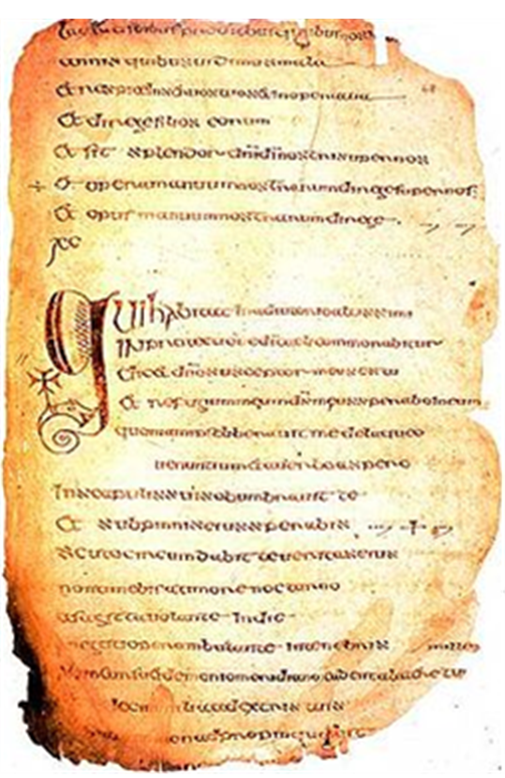
From Colmcille and Cows to Smartphones and Writoids
6th Century
1439
1710
1886
1911
1963
1989
2000
2007
2019
2022

Slide 5
Copyright protects…
Original literary, dramatic, musical and artistic works (classical works)
Sound recordings, films, broadcasts, cable programmes, typography of published editions
(related rights)
Original – must not be merely copied from other sources and must demonstrate “labour, skill or judgement”
Ideas – are not protected only their tangible expression
Computer software and databases
Performances

Slide 6
Copyright protects…
The exclusive rights of the author
An employee is an exception
The author owns the rights in a commissioned work
For how long?
Lifetime plus 70 years for the classical works
50 years for the related rights

Slide 7
Exclusive Rights
Copying
Making available to the public
Making an adaptation
Performance
Display
Rental & Lending

Slide 8
Moral Rights
Paternity right
Integrity right
Vindicate the personal rights of authors as opposed to economic rights
More common in civil law jurisdictions
UK & Ireland since 2001 (EUCD & CRRA)
False attribution

Slide 9
Related Rights
Rights in a creative work which are not connected to the work’s actual author
‘Authors’ Rights’ and ‘Neighbouring Rights’
Droit d’auteur et droits voisins
Performers
Producers
Broadcasters

Slide 10
And now onto the issue of the day …
Artificial Intelligence is rapidly changing the creative industries, and this poses a number of threats to creators.
Almost as fast as I can prepare this presentation, the landscape is changing.
Many creators are using GenAI as part of their creative process, but AI models are being trained on copyright works without permission and generating new works that risk being indistinguishable from human-created works
Notes:
In some ways nothing has changed … in other ways, everything has. The technology is not new but the scale of data, speed of hardware, ease of use and the difficulty distinguishing between AI created, AI assisted and human created works increases almost daily.

Slide 11
Generative AI – defining what we mean

Slide 12
GENERATIVE AI Definition time!
ARTIFICIAL INTELLIGENCE
- a field which combines computer science and robust datasets to enable problem solving
- the simulation of human intelligence processes by machines, especially computer systems
GENERATIVE ARTIFICIAL INTELLIGENCE
- a type of artificial intelligence technology that can produce various types of content, including text, imagery, audio and synthetic data
- learns the patterns and structure of the input training data and generates new data with similar characteristics
Notes:
Artificial Intelligence refers to the application of computers to tasks for which human intelligence was traditionally required.
The definition, scope and usage of the term have all changed since it was first talked about.
Computers have advantages with their capactiy to process large (vast) quantities of data BUT what can they be relied upon to do with that data
Generative AI
Open AI’s Chat GPT, Google’s BARD and Meta’s LLaMA are all examples of Large Language Models – LLMs learn the relationship between words through processing vast quantities of human-generated text. It learns to parse and formulate linguistic constructs such as nouns, verbs, sentence formation, paragraph structure … it is quite simply learning based on complex statistics relating to word relationships and occurrence frequencies.

Slide 13
Large Language Models
Chat GPT trained on 300 billion words via documents, books, websites
Human feedback to reinforce preferred responses
‘Preferred responses’ relied upon
Potential bias – inherent bias
Hallucination
Notes:
Human feedback from people who are specifically not subject matter experts on the best answer from a selection of alternatives
Chat GPT uses grammar rules to structure a sonnet similar to how a computer can beat a Grand Master at chess BUT it cannot think for itself and extrapolate ideas beyond the tasks it has been trained to complete.
Chess, and writing sonnets, are highly structured activities with clear rules.
However, with more subtle tasks or more obscure topics LLMs are prone to ‘hallucination’ which leads to wildly inaccurate assertions

Slide 14
Input – datasets, training and ©

Slide 15
Datasets
BIG DATA – the confluence of volume, velocity and variety of information
Faster, larger and more varied the data, the better the AI model will be!
Unstructured (95%) data and Structured data
Data Gathering – Facebook / Google private companies with access to wide variety of data
Publicly or not publicly available
Best source of data is the Internet
Notes:
Unstructured data has not been collected with pre-existing parameters or structures and makes up about 95% of Big Data
Structured data is collected and organised in a systematic manner using specific models
Data gathering is most often automated and large scale

Slide 16
Books
Chat GPT 3 was trained on a dataset obtained via web crawl searches, some from books and some from websites such as Wikipedia
16% from datasets created by others
Books1 – probably out of copyright works via Project Guttenberg (12 billion tokens)
Books2 – remains a mystery (55 billion tokens)
Books3 - ???
Notes:
“reading the internet” metaphor obscures the fact that content from publishers has been essential to the training of the existing models. The “content from publishers” I mean includes caches of pirated ebooks, as well as datasets like all of Google Books which are not available to anyone just “reading the internet”. When the good folks at Eleuther.AI released The Pile dataset (later used by Facebook, Microsoft and nVidia to train models), they justified including Shawn Pressler’s scrape of the Bibliotik cache of 196,640 pirated ebooks by saying “We included Bibliotik because books are invaluable for long-range context modeling research and coherent storytelling.”

Slide 17
Chinchilla and Llama
Chinchilla (Google) – trained on 1.4 trillion tokens
420billion ‘Books dataset’ 4 million works
There are 14 million books in the British Library (a copyright archive library since the 1800s)
Llama (Meta) 2 billion tokens
‘a new mix of publicly available online data’
Copyright holders now citing specific datasets in their lawsuits means less detail being shared by AI companies

Slide 18
Bloomberg
Opted to train its inhouse LLM on the Pile ‘publicly available data’ which includes a minimum of 197,000 pirated e-books, news content and other publisher owned material
Not live yet due to ongoing problems with hallucination (despite half the data being Bloomberg’s own corpus of information)
Q: quality of data does not seem to resolve hallucination!

Slide 19
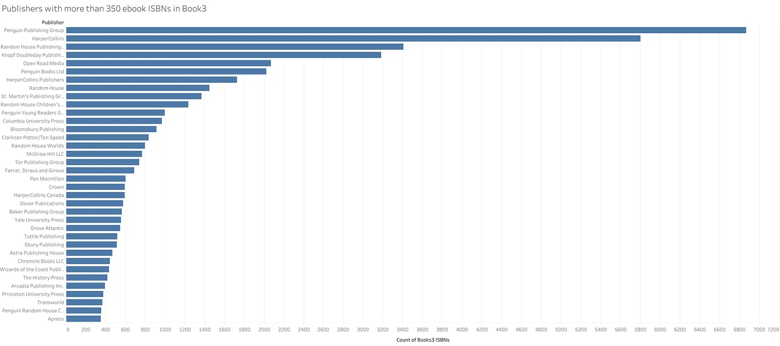
The books used to train LLMs
If you want to search the Books3 / The Pile
https://github.com/psmedia/Books3Info
Notes:
The publisher with the most number of ebook titles included in this filtered list: Penguin Publishing Group, with 6866 ISBNs, but see also Penguin Books Ltd (2024 ISBNs), Penguin Young Readers Group (997), Penguin Random House Children's UK (353)
Number of publishers with more than 350 titles in the database: 36
Year of publication for the largest group of ISBNs - 2012 (with 7525 ISBNs published that year).

Slide 20
Output – using AI to generate content

Slide 21
Things to think about
Generating using prompts
Uploading content and asking Model to rewrite/expand/correct/etc
If you upload original content – what are the terms of use by the LLM?
Are you providing your material for free?

Slide 22
Different things to think about
Do you want your work to use …
AI generated book covers
AI generated translation
AI generated narration
Ensure that you control how AI has access to your work, your style and your voice
Consider a clause to forbid the use of your work to assist machine learning

Slide 23
Your use of AI as a tool
If something is free you are the product
If you use AI for research or editing – check for accuracy
Label and identify AI generated or AI assisted content
Use a filter to exclude AI generated images if sourcing images for your work
Check T&Cs of cloud services when uploading your work

Slide 24
Authors Guild Letter
KPMG estimated that up to 43% of the work of authors, writers and translators could be replaced by generative AI
The Authors Guild have an Open Letter to generative AI leaders which you can sign
https://actionnetwork.org/petitions/authors-guild-open-letter-to-generative-ai-leaders

Slide 25
Self-publishing
On 11th September Amazon announced new terms AI Guidelines for Kindle Direct Publishing (KDP)
https://www.theguardian.com/books/2023/sep/11/self-publishers-must-declare-if-content-sold-on-amazons-site-is-ai-generated

Slide 26
What’s next?

Slide 27
Through the Courts
Thaler v Permutter – the inventor of an AI Image Generator sued the US Copyright Office for refusal to register a work created exclusively by AI
Andersen v Stability AI Ltd – scraping billions of copyright images (dismissed)
Doe v GitHub Inc – developers of code (dismissed) (not copyright infringement but
Tremblay v OpenAI Inc – copyright infringement of authors
Silverman v Open AI Inc - similar

Slide 28
Other responses
The New York Times blocked Open AI’s web crawler – preventing Open AI from using its content to train AI models (21 August 2023)
The Guardian has blocked OpenAI from trawling its content (1st September 2023)
CNN, Australia’s ABC, Reuters, Chicago Tribune, The Canberra Times blocking …
Agence France-Presse and Getty Images called for regulation of AI, including transparency around datasets used for training
Google proposes that AI systems should be able to scrape the work of publishers unless they specifically opt out

Slide 29
Legislation
Europe – the AI Act is underway which will include regulation around transparency
France – published draft AI Act 15th September 2023 including licensing, remuneration and explicit statement of AI involvement in a work
USA – US Copyright Office has launched a consultation on AI and copyright
Singapore – National Artificial Intelligence Strategy (and amendment of some laws)

Slide 30
And finally, what can you do?
Human Artistry Campaign
https://www.humanartistrycampaign.com/
Letter of non-consent
https://ivorsacademy.com/news/take-action-on-ai-send-a-letter-of-non-consent-and-protect-your-rights/
(this one is an example for music but easily adaptable)
European Writers Council #AgAInstWritoids
www.againstwritoids.org
Society of Authors advice
https://www2.societyofauthors.org/2023/06/07/artificial-intelligence-practical-steps-for-members/

Slide 31
Thank you for listening
Find out more at www.icla.ie

